Slide 1

North South University
Department of Electrical and Computer Engineering
Spring, 2020
CSE 299
Section- 12
Project Title: Doctor and Patient management system

Slide 2
Project Presentation
Submitted to:
Intisar Tahmid Naheen (ITN)
Submitted by:
Md Sharif Hossain - 1712336642
Rubaida Ferdous - 1711126642

Slide 3
Introduction
This is a web-based management system where there will be a patient’s and doctor’s ID(s). Registered doctors can prescribe for a patient and it will be stored in the patient’s ID. No unregistered doctors can prescribe a patient and no doctor can prescribe anything out of a licensed medicine list.

Slide 4
Background
In some hospitals, there is usage of the online system but in general there is no existence of such service.

Slide 5
Objectives
The objectives of this project/thesis are to:
Ensuring registered doctors for each patient
Banning the unlicensed medicines
Ensuring digital printed prescriptions for the patients.
Storing people’s medical history for later use and research
Providing free online health guide
Central blood bank
24/7 medicine home delivery
Authentic financial fundraising
Common communication platform among doctors etc.

Slide 6
Methodology and Approach
There is a list of all registered doctors from administration. Doctor’s ID will be created from admin.
Patients can sign in their accounts. Their password will be encrypted and saved in the database.
No doctors can give prescription without an account from the administration.
Doctors cannot prescribe medicines out of the database connected to the system.
All medical history of a patient will be recorded so that one can find any history whenever s/he needs that.

Slide 7
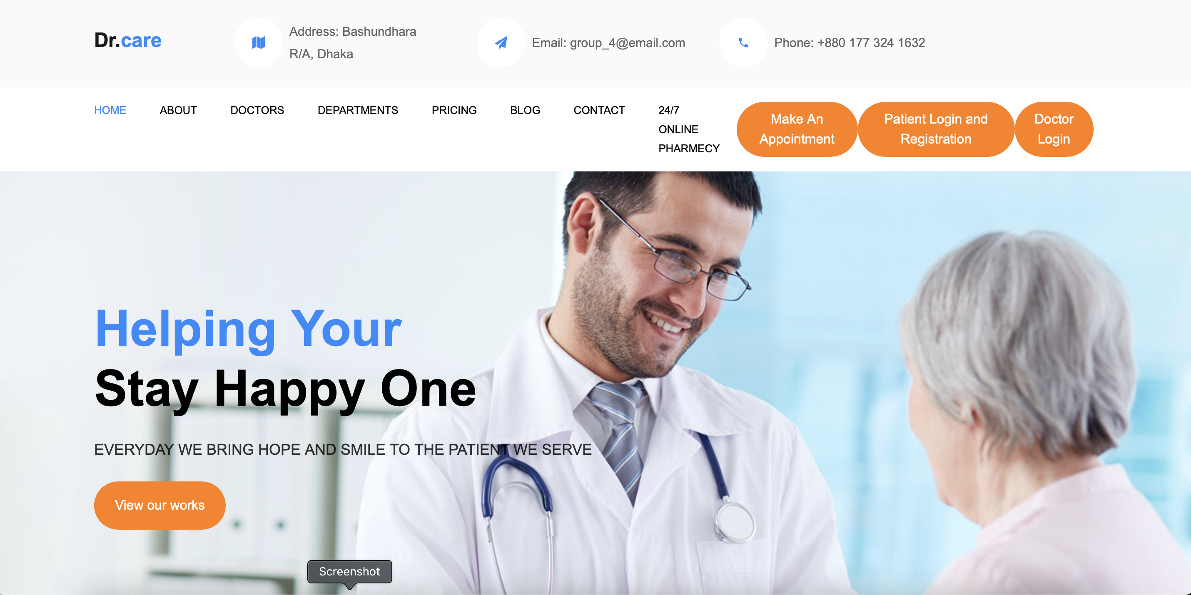
User Interfaces
1. There is a user-friendly homepage for all common users.
Figure 1: Homepage

Slide 8
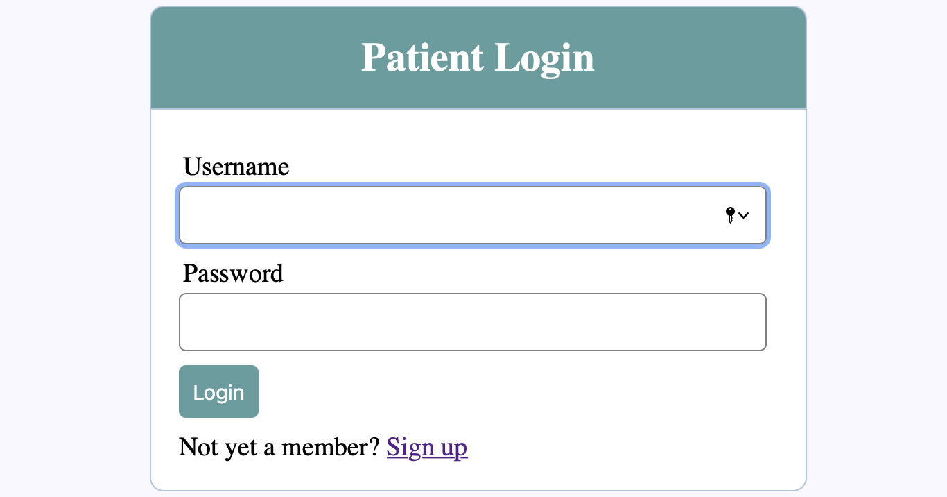
User Interfaces
2. Users have a login and registration page. Patients must be registered before login. Anyone can register or sign up by providing a unique user name, email, and a password. The password will be encrypted and saved in the database.
Figure 2: Patient Login page

Slide 9
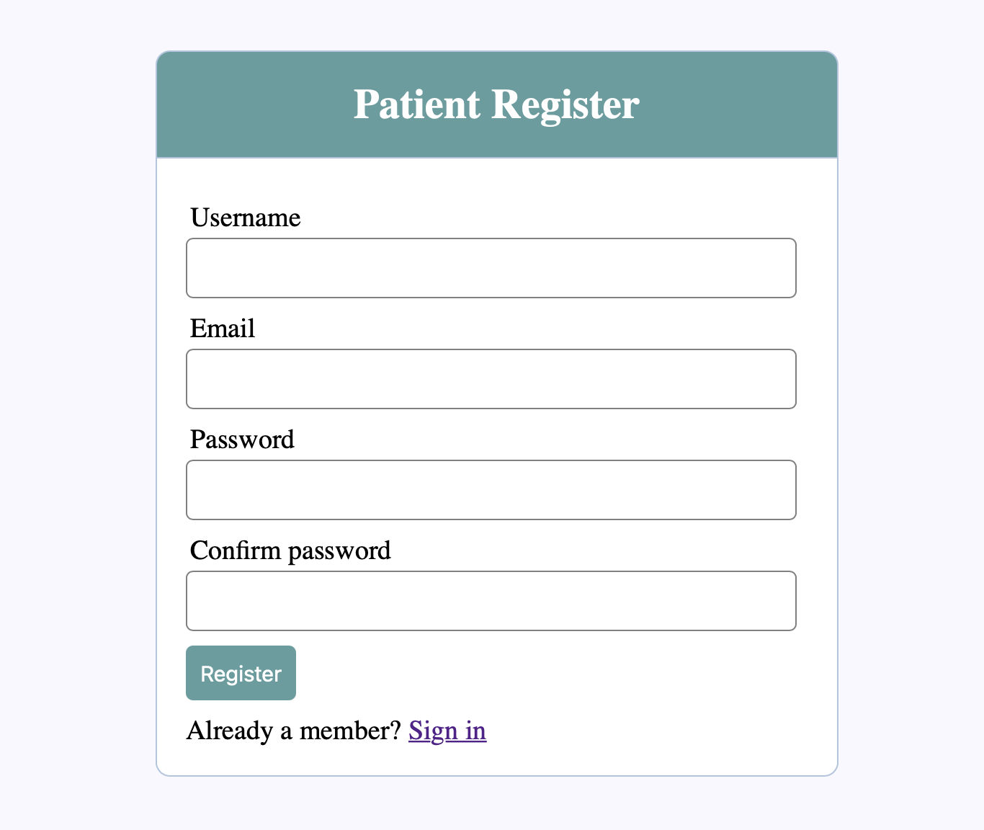
User Interfaces
Figure 3: Patient Registration page

Slide 10
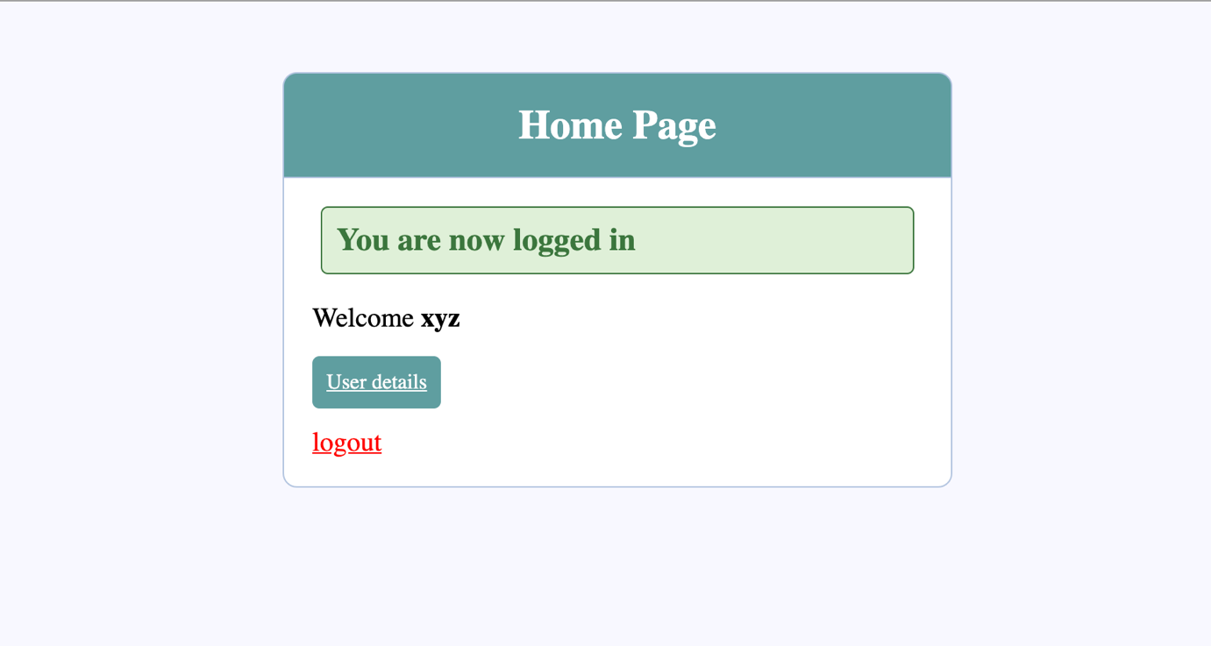
User Interfaces
3. Users will find a dashboard after login.
Figure 4: User dashboard

Slide 11
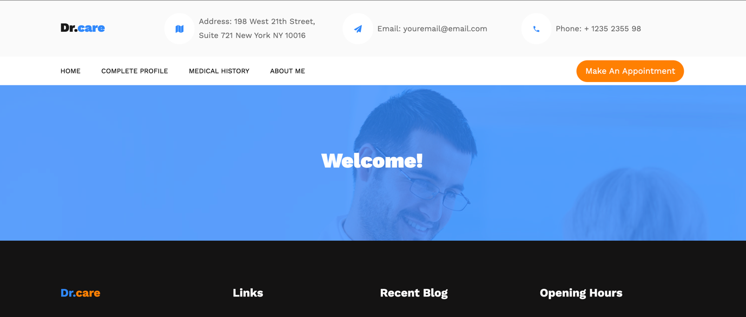
User Interfaces
4. Users can find their activity page inside “User details”
Figure 5: User activity page

Slide 12
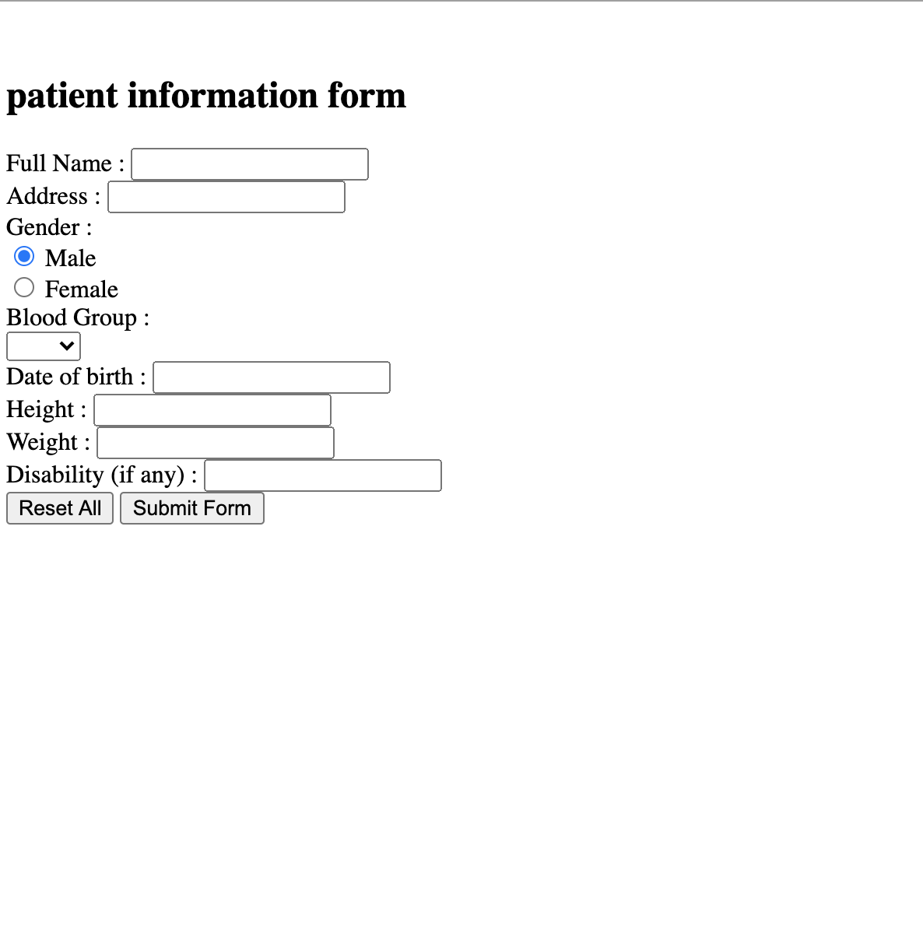
User Interfaces
5. Users can update their additional information in the “Complete Profile” and view it in the “About me” option.
Figure 6: Complete profile form

Slide 13
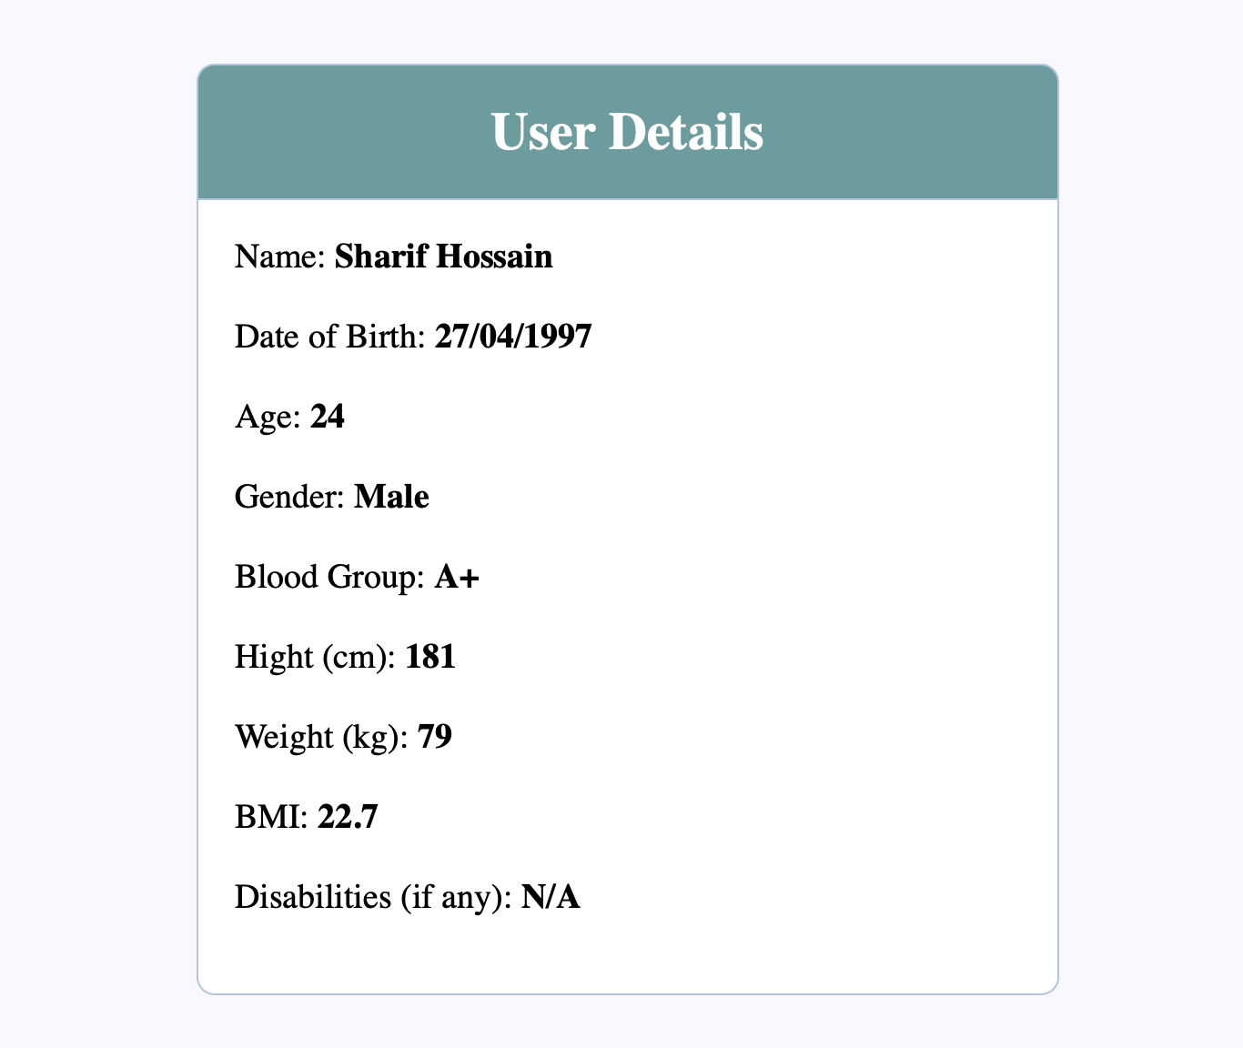
User Interfaces
Figure 7: User Details

Slide 14
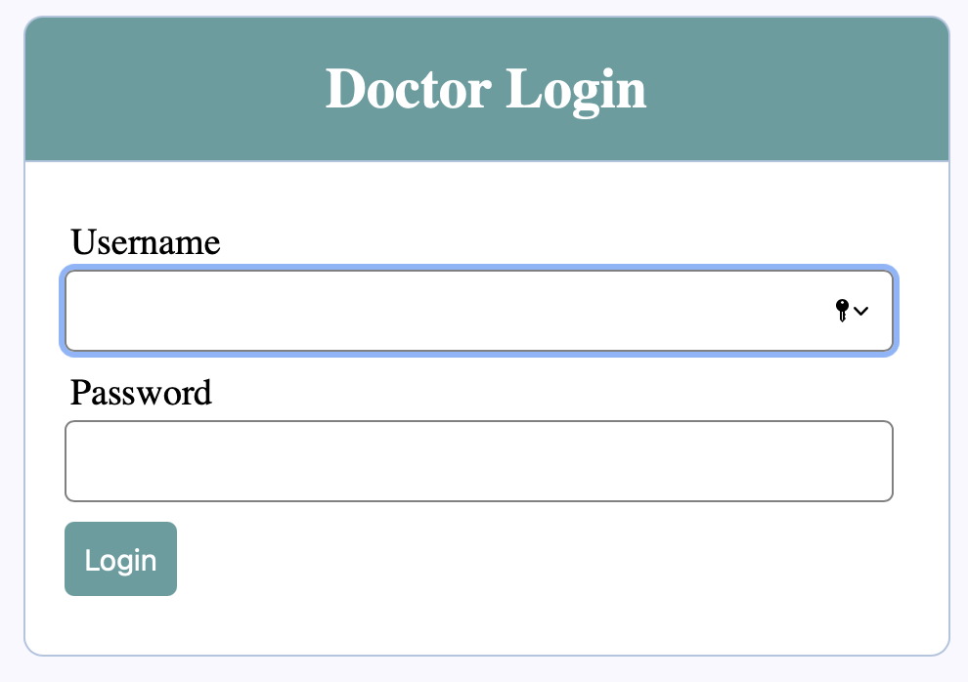
User Interfaces
6. Doctors are registered from admin. They will use a pre-registered User ID and password.
Figure 8: Doctor Login Page

Slide 15
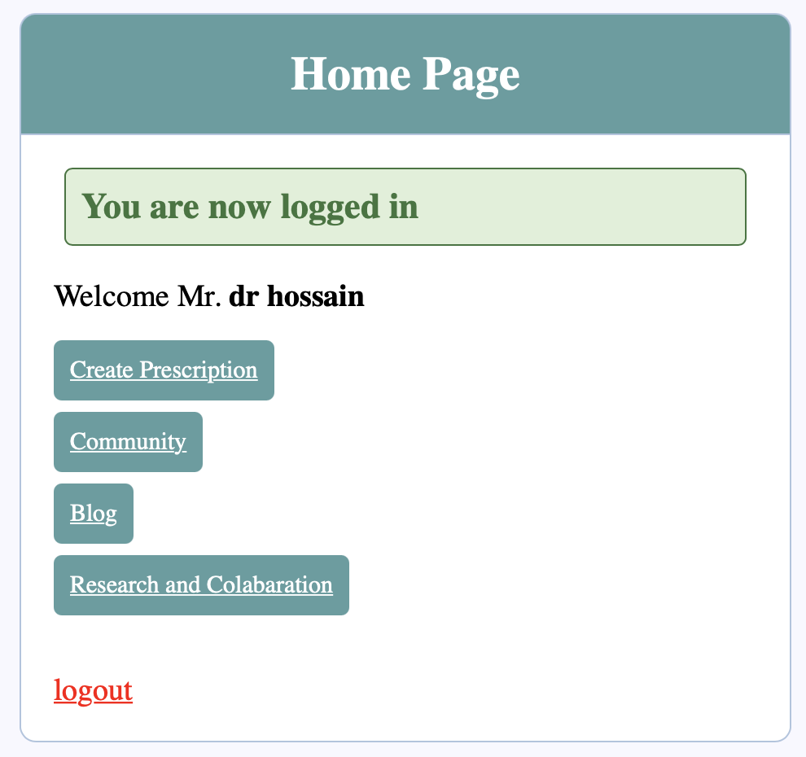
User Interfaces
6. Doctors are registered from admin. They will use a pre-registered User ID and password.
Figure 9: Doctor Dashboard

Slide 16
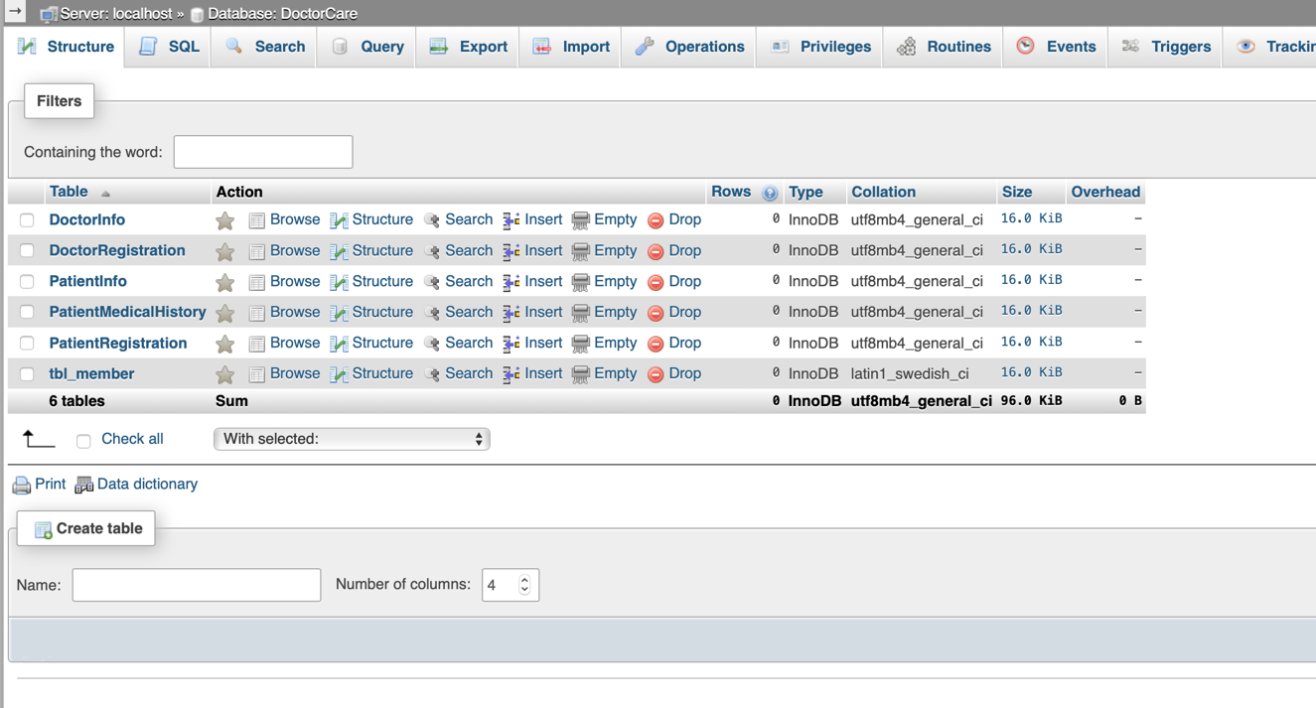
Database
The database is created using MySQL on the Apache server.
Figure 10: Database tables

Slide 17
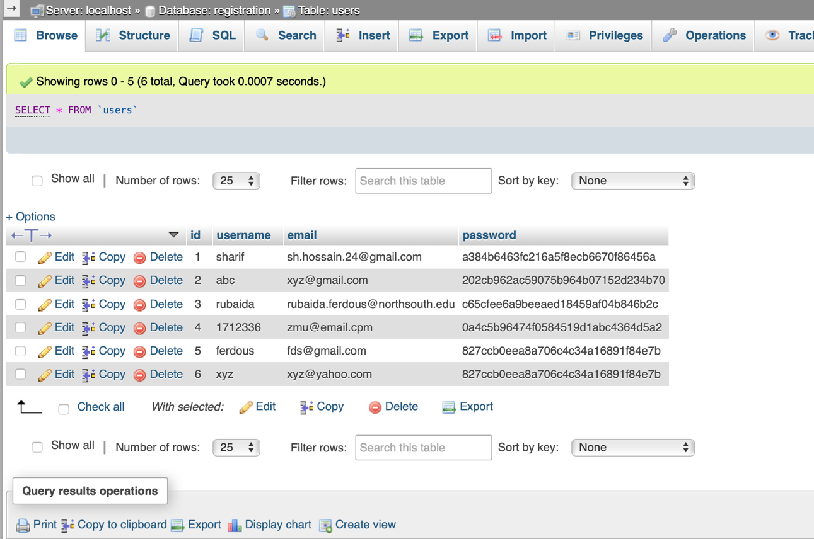
Database
User id and email are saved according to inputs and password is stored after encryption.
Figure 11: Login table and registration data

Slide 18
Budget
As it is a web-based software system, initially no specific budget is applicable for the application. It was created by using all free sources.

Slide 19
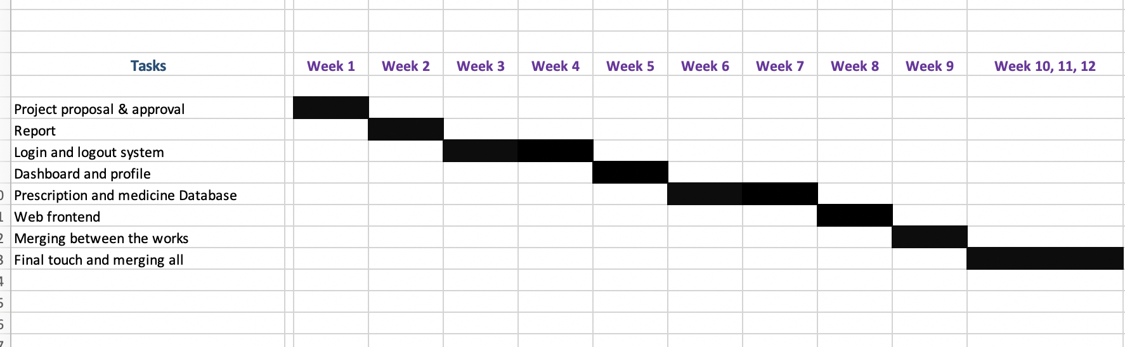
Time Plan
Figure 12: Gantt chart

Slide 20
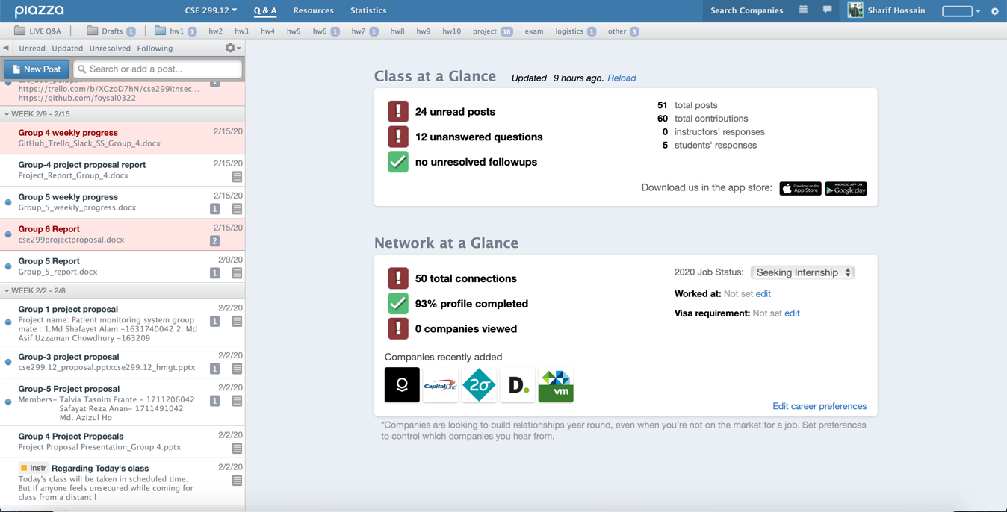
Used Platform:
1. Course communication in Piazza
Figure 13: Updates in Piazza

Slide 21
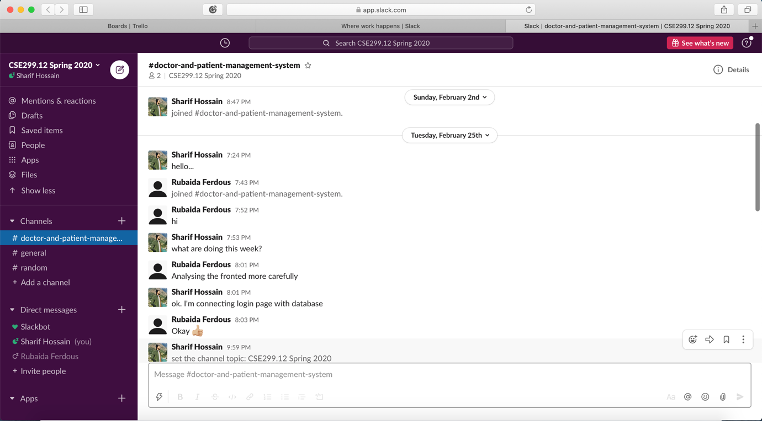
Used Platform:
2. Group Communication in Slack
Figure 14: Communicating in slack among groupmates

Slide 22
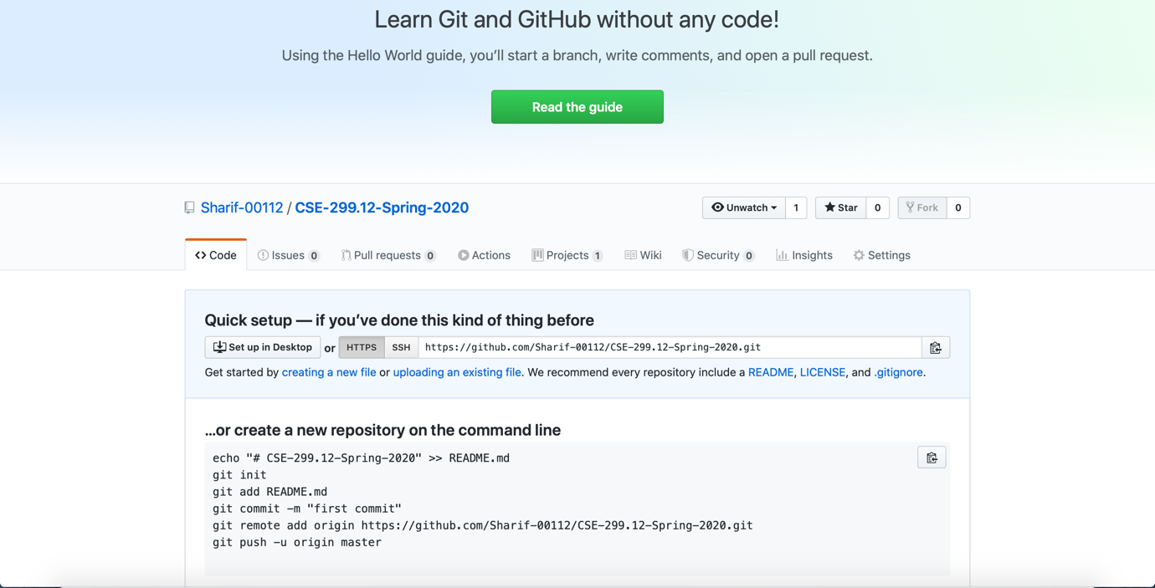
Used Platform:
3. Project sharing repository in GitHub
Figure 15: GitHub repository

Slide 23
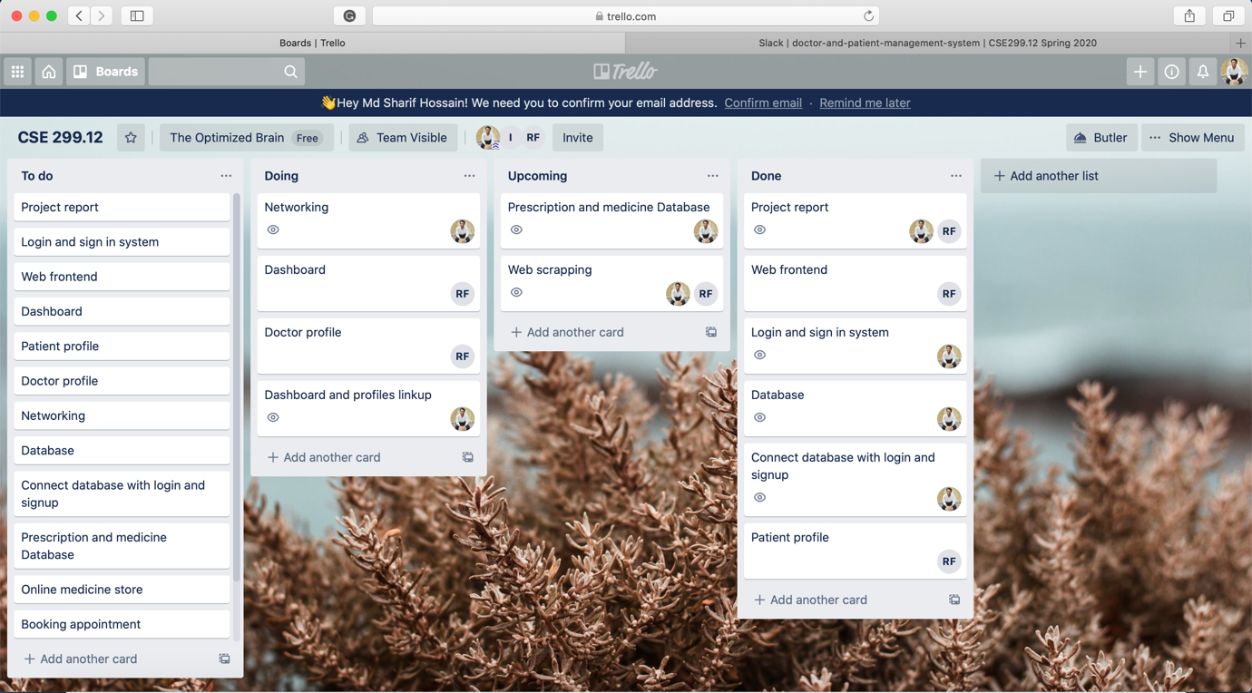
Used Platform:
4. Tracking weekly activities in Trello board
Figure 16: Trello Board

Slide 24
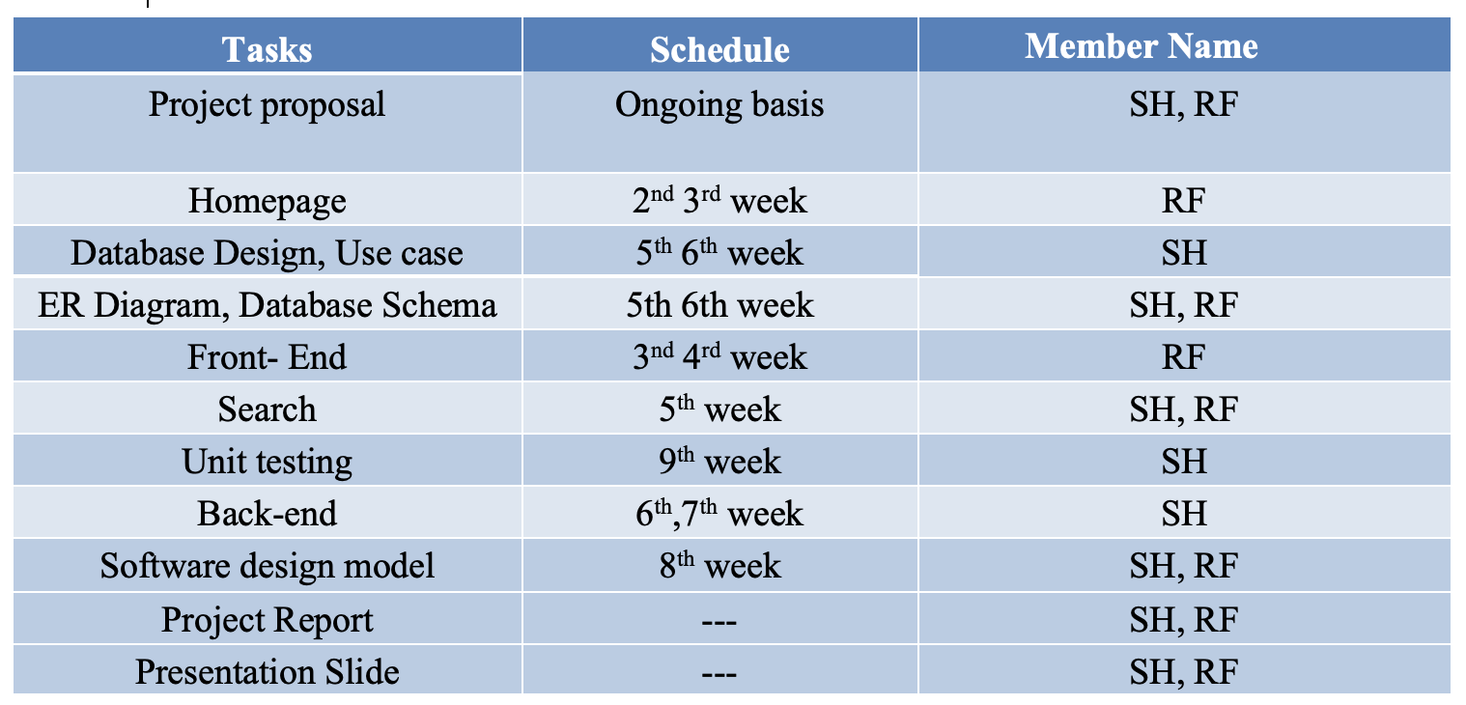
Contributions
Md Sharif Hossain (SH), Rubaida Ferdous (RF)
Figure 17: Contribution Table

Slide 25
Result Analysis
At the end of the semester, it was hoped to build a stable platform which could be used as a demo of the offered project.

Slide 26
Conclusion and Future work
Updates of the first six weeks were almost according to the time plan. Unfortunately, after the outbreak of the Covid-19 Corona Virus and lockdowns, further updates couldn’t be made. In the circumstances, it is requested to consider the project accordingly.

Slide 27
Thanks to all!
?

